Slide 1
INDIAN INSTITUTE OF TECHNOLOGY KANPUR
INTRODUCTION TO AI AND IOT
AUDIO EVENT DETCTION
TEAM-42
Sayantan Das
Sourav Kumar
Rohit
Satyabrata Maharana
Deepak Kumar

Slide 2
AUDIO EVENT DETECTION
Audio or Sound event detection aims at processing the continuous acoustic signal and converting it into symbolic descriptions of the corresponding sound events present at the auditory scene. Sound event detection can be utilized in a variety of applications, including context-based indexing and retrieval in multimedia databases, unobtrusive monitoring in health care, and surveillance. It is one of the emerging topics of CASA research.

Slide 3
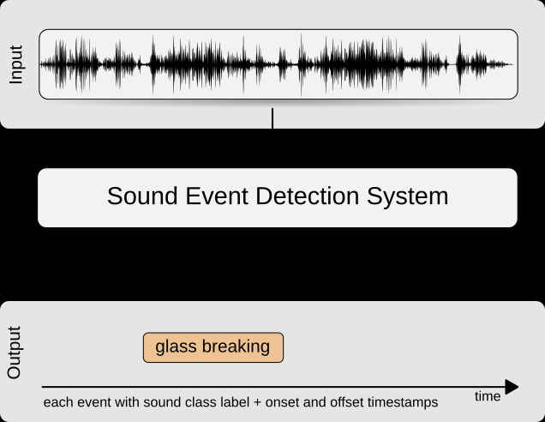

Slide 4
SOURCE OF INFORMATION
DCASE 2017
http://dcase.community/challenge2017/task-rare-sound-event-detection

Slide 5
TASK
This task will focus on detection of rare sound events in artificially created mixtures. This specific use of data will allow creating mixtures of background everyday audio and sound events of interest at different event-to-background ratio, providing a larger amount of training conditions than would be available in real recordings.

Slide 6
DATASET
Dataset consists of isolated sound events for each target class and recordings of everyday acoustic scenes to serve as background.
The target sound event categories are:
Baby crying
Glass breaking
Gunshot
For traning 500 samples of each categories
For traning 500 samples of each categories

Slide 7
Included libraries
import librosa
import librosa.display
import pandas as pd
import numpy as np
from sklearn.preprocessing import LabelEncoder
from keras.utils import np_utils
from keras.models import Sequential
from keras.layers import Input, Dense, Dropout, Activation, Flatten
from keras import optimizers
from sklearn.metrics import confusion_matrix
from sklearn.metrics import f1_score

Slide 8
EXTRACTING FEATURES FROM AUDIO FILE
def parser_Val(row):
file_name = precedeString_Val + '/' + row.ID + '.wav'
try:
val_X, sample_rate = librosa.load(file_name,res_type='kaiser_fast')
mfccs = np.mean(librosa.feature.mfcc(y=val_X, sr=sample_rate, n_mfcc=40).T,axis=0)
except Exception as e:
print("Error encountered while parsing file: ", file_name)
return None, None
feature = mfccs
label = row.CLASSES

Slide 9
MODEL
#input_layer=Input(shape=(X.shape[1:]))
model = Sequential()
model.add(Dense(256, input_shape = (40,)))
model.add(Activation('relu'))
model.add(Dense(256))
model.add(Activation('relu'))
model.add(Dropout(0.1))
model.add(Dense(256))
model.add(Activation('relu'))
model.add(Dropout(0.1))
model.add(Dense(256))
model.add(Activation('relu'))
model.add(Dropout(0.1))
model.add(Dense(num_labels))
model.add(Activation('sigmoid'))
sgd = SGD(lr=0.001, momentum=0.9, decay=1e-6, nesterov=True)
model.compile(loss='binary_crossentropy', optimizer=sgd, metrics=['accuracy'])
model.fit(X,y, epochs=500,validation_split=0.1)

Slide 10
ACCURACY AND F1 SCORE
ACCURACY-70
F1 SCORE-0.37

Slide 11
LIVE DEMO

Slide 12
THANK YOU

